Slide 1
Exploratory Data Analysis Titanic Dataset

Slide 2

Initial plan for data exploration
Data Overview
Delete Columns Not Useful Discriminate Target
Missing Values Identification And Treatment
Outliers Detection And Treatment
Feature Engineering
Visualizations on insights
Hypothesis Testing

Slide 3
Data Overview
The dataset has 12 rows and 891 columns.
There are 7 numerical columns and 5 columns with text data.
There are some columns with missing values
Dataset has columns with categorical data like Pclass,Survived,Sex,Embarked

Slide 4

Brief description of the data set and a summary of its attributes
PassengerId : int64 : Ids given to pax while boarding cruise
Survived : int64 : Survival status of pax,(0 = No; 1 = Yes)
Pclass : int64 : Class of pax in cruise. (1 = 1st; 2 = 2nd; 3 = 3rd)
Name : object : Name of Pax
Sex : object : Gender of pax
Age : float64 : Age of pax
SibSp : int64: Number of Siblings/Spouses Aboard
Parch : int64 : Number of Parents/Children Aboard
Ticket : object : Ticket Number of pax
Fare : float64 : Passenger Fare
Cabin : object : Cabin
Embarked : object : Port of Embarkation (C = Cherbourg; Q = Queenstown; S = Southampton)

Slide 5
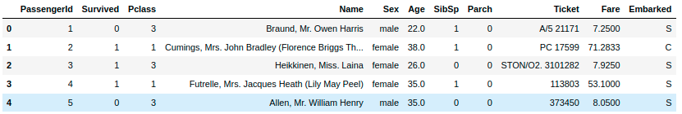
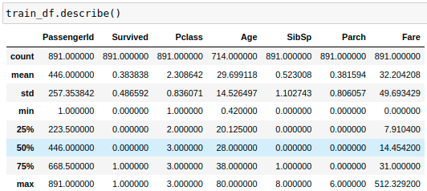
Brief description of the data set and a summary of its attributes

Slide 6
Delete Columns Not Useful Discriminate Target
There are columns like
1. PassengerId
2. Cabin
3. Ticket
4. Name
Which are not useful to predict the target variable.
Hence have deleted those column

Slide 7
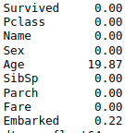
Missing Values Identification And Treatment
Column Age and Embarked have null values.
Embarked column has only 0.22% values are null hence imputed them with mode.
Age column have 19.87% null values which is significant number hence decided to input those values rather than deleting them.

Slide 8
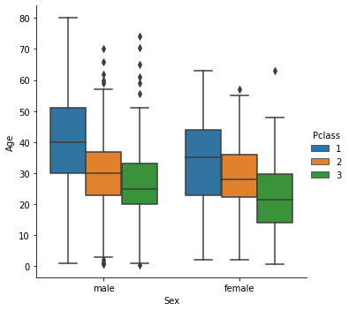
Missing Values Identification And Treatment
Null values of Age column has been filled by finding its correlation with Pclass and taking means of those values.

Slide 9
Outliers Detection And Treatment
There are outlier detected in below columns.
Age
SibSp
Parch
Fare
Since outliers in SibSp and Parch are valid values which would not affect predictions significantly.

Slide 10
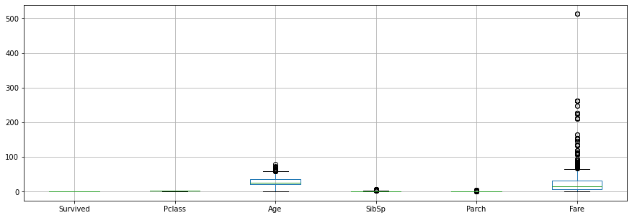
Outliers Detection And Treatment
Outlier under column Age and Fare has been removed using Z-score methods.

Slide 11
Feature Engineering
Checked the distribution of numerical columns.
Found that numerical columns are following the approximate normal distribution
Checked the categorical columns and identified the requirement of encoding.
For Sex column nominal encoding applied.
Female = F
Male = M

Slide 12
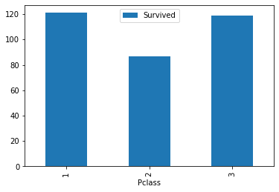
Visualizations on insights
Survival status of second
class is less as compared
to first and second class

Slide 13
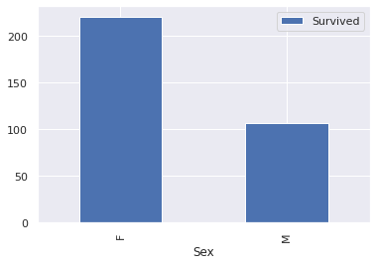
Visualizations on insights
It can be seen that
more female survived
than men

Slide 14
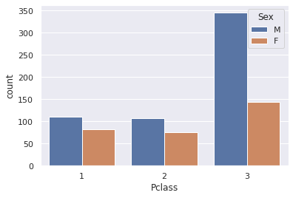
Visualizations on insights
Male often choose to
travel in third class
where female are less
likely to choose third
class

Slide 15
Hypothesis Testing : Pclass Against Survival Rate
Main Purpose : Check if Plcass has affecting the survival rate
Null Hypothesis: The socio-economic class of the people didn’t have an effect on the survival rate.
Alternative Hypothesis: The socio-economic class of the people affected their survival rate.
P_value : 5.645603538613823e-147
Null Hypothesis Rejected
It indicating that socio-economic class of the people may have an effect on survival rate.

Slide 16
Hypothesis Testing : Sex Against Survival Rate
Main Purpose : Check if gender has affecting the survival rate
Null Hypothesis: Gender of the people didn’t have an effect on the survival rate.
Alternative Hypothesis: Gender of the people affected their survival rate.
P_value : Is closed to zero
Null Hypothesis Rejected
It indicating that gender of the people may have an effect on survival rate.

Slide 17
Hypothesis Testing : Sex against Pclass
Main Purpose : Check if gender has affecting to choose the Pclass
Null Hypothesis: Gender of the people didn’t have an effect on the Pclass.
Alternative Hypothesis: Gender of the people affected their Pclass.
P_value : 2.1701131381042185e-19
Null Hypothesis Rejected
It indicating that gender of the people does affect while choosing the Pclass

Slide 18
Conclusion
As shown in analysis, logistic regression can be a good machine learning algorithm to predict the survival status of passenger.
Provided datasets proves a significant correlation between the socioeconomic class and the survival rate.
Provided datasets proves a significant correlation between the sex and the survival rate.

